Slide 1
Machine Learning
Predict House Prices in Salt Lake City
Vincent La
Neumont College
Notes:
Hi, my name is Vincent, and today we’ll be doing a topic discussion on Machine Learning and do a mini group exercise predicting housing prices in Salt Lake City to apply our learnings!

Slide 2
Our Goals Today
What is Machine Learning?
Learn our first algorithm: Linear Regression
Group Exercise predicting housing prices in Salt Lake City!

Slide 3
What is Machine Learning
“[Machine Learning] is the field of study that gives computers the ability to learn without being explicitly programmed.”
- Arthur Samuel (1959)
Notes:
https://en.wikipedia.org/wiki/Arthur_Samuel American Computer Scientist who popularized the term “Machine Learning” in 1959

Slide 4


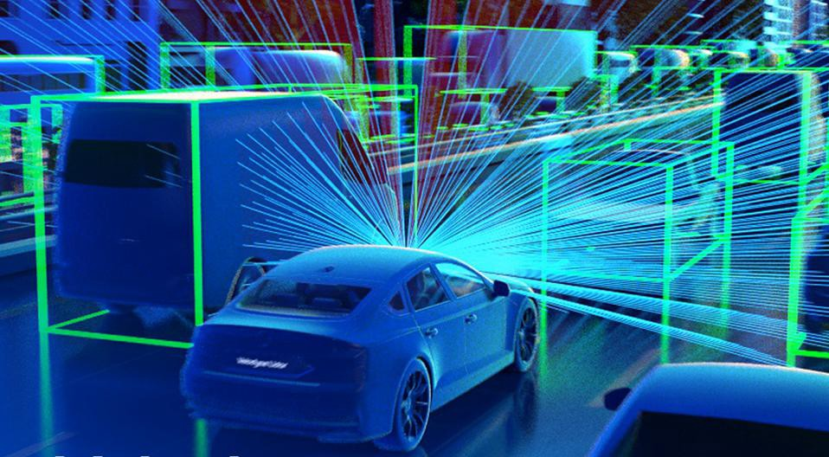
Machine Learning is All Around us!
Netflix
Financial Institutions
Automobile Industry
Recommending movies for you to watch
Identifying credit card fraud to protect you
Building self-driving cars
Notes:
Netflix: https://towardsdatascience.com/deep-dive-into-netflixs-recommender-system-341806ae3b48
Spotify:

Slide 5
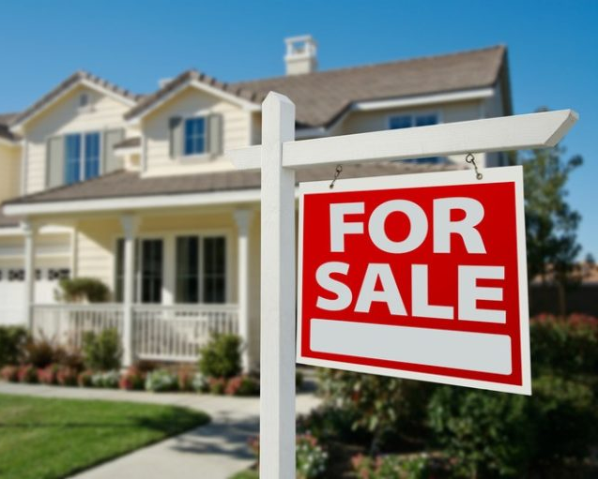
Exercise: Predicting Home Prices
Why do we care?
Overbid – you pay too much for your home!
Underbid – your offer will not get accepted, no home purchase!

Slide 6
Our first Machine Learning Algorithm: Linear Regression
Linear Regression is a machine learning model in which the model finds the best fit linear line between the predictors and outcome variable.

Slide 7
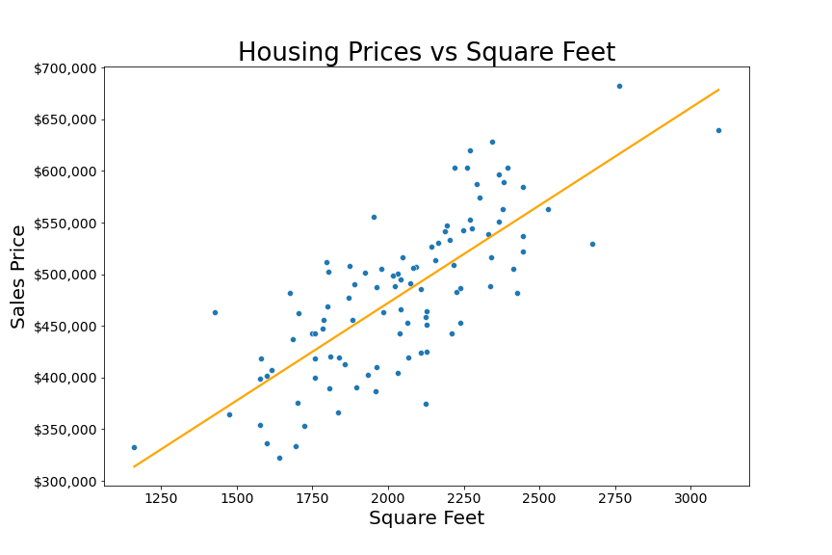
Linear Regression: Predicting Home Prices
Linear Regression Prediction Line
The machine learning model predicts “Sales Price” as a function of “Square Feet” using a “line of best fit” on the data.
Outcome Variable
Predictor

Slide 8
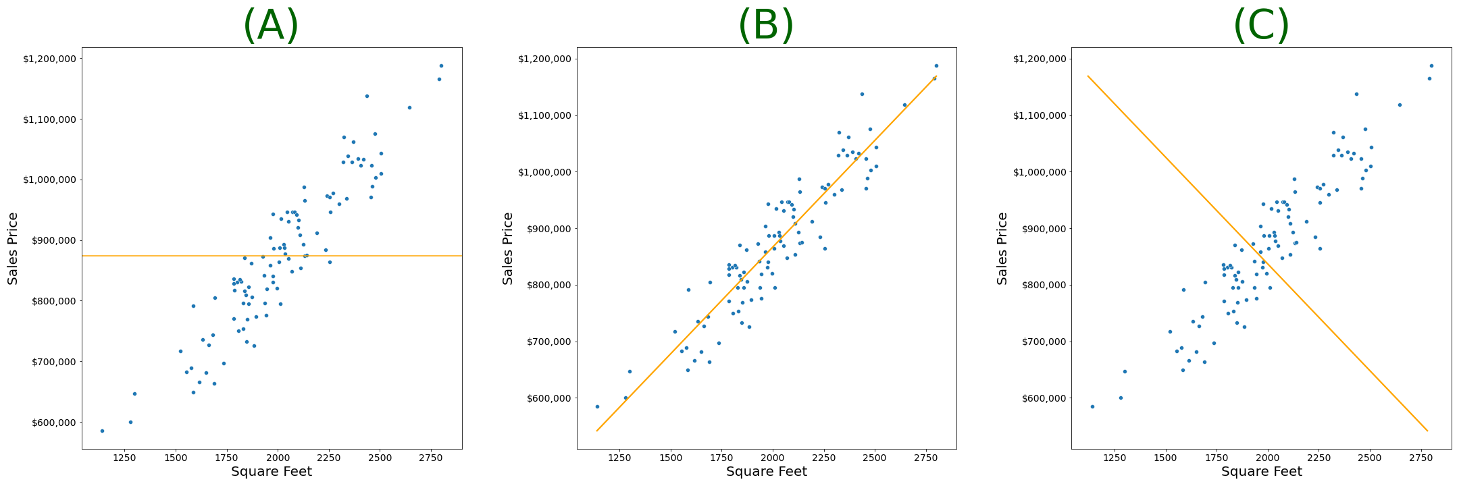
Group Exercise: Pick the Right model!
Notes:
Bonus Question
What does the model presented in (A) suggest about the relationship between square feet and sales price?
What does the model presented in © suggest about the relationship between square feet and sales price?

Slide 9

Congratulations!

Slide 10
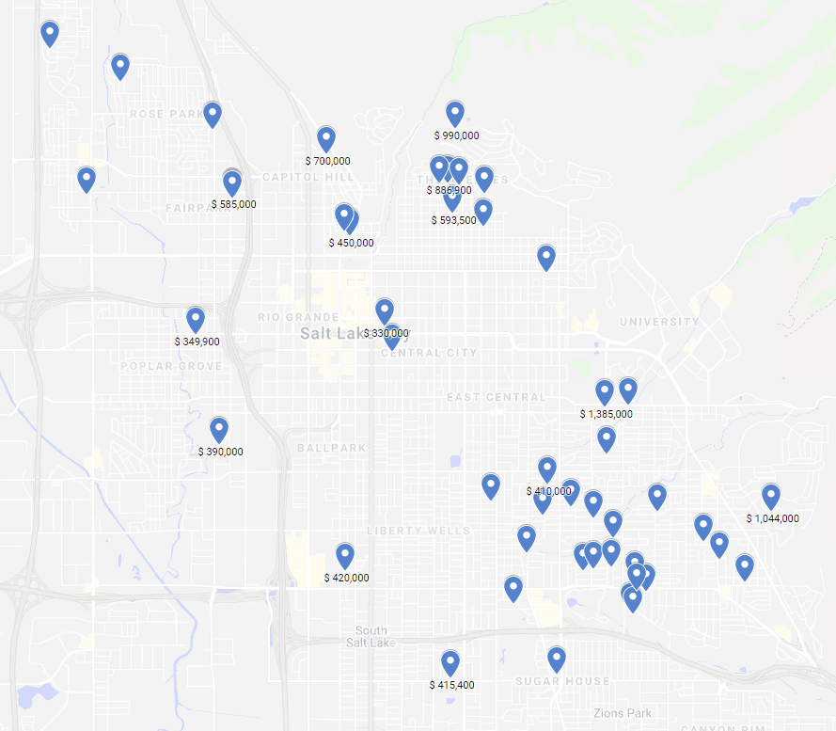
Another Group Exercise!
Residential Home Sales Prices in Salt Lake City
Google Maps Link

Slide 11
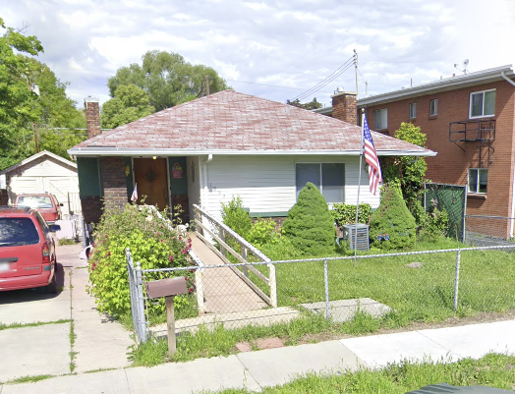
Predict the Price!
1832 S 1100 E, Salt Lake City, UT 84105
Square Ft: 1393
Bed Rooms: 2
Bathrooms: 1
Notes:
1832 S 1100 E, Salt Lake City, UT 84105
Add a view in Google My maps without the prices

Slide 12
Other Homes
Square Ft | Bed Rooms | Bathrooms | Price
1385 | 2 | 2 | $450,000
1634 | 4 | 2 | $620,000
1270 | 2 | 2.5 | $275,000
1475 | 2 | 1 | $420,000
1124 | 2 | 2 | $332,100
Square Ft: 1393
Bed Rooms: 2
Bathrooms: 1
Guesses
Participant | Guess Sales Price
True Price: $698,600
Model Predicted Price: $470,977
Notes:
1832 S 1100 E, Salt Lake City, UT 84105

Slide 13
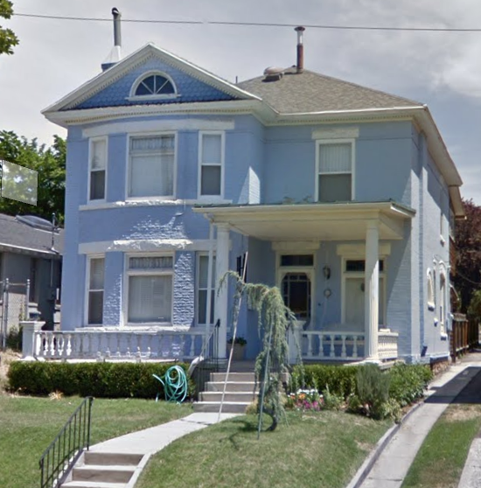
Predict the Price!
7 S 1200 East, Salt Lake City, UT 84102
Square Ft: 3259
Bed Rooms: 3
Bathrooms: 2.5
Notes:
7 S 1200 East, Salt Lake City, UT 84102
Add a view in Google My maps without the prices

Slide 14
Other Homes
Square Ft | Bed Rooms | Bathrooms | Price
2775 | 6 | 2 | $551,000
1634 | 4 | 2 | $620,000
2623 | 4 | 3 | $850,000
2000 | 3 | 2 | $735,000
2083 | 3 | 2 | $886,900
Square Ft: 3259
Bed Rooms: 3
Bathrooms: 2.5
Guesses
Participant | Guess Sales Price
True Price: $850,000
Model Predicted Price: $924,876
Notes:
7 S 1200 East, Salt Lake City, UT 84102

Slide 15
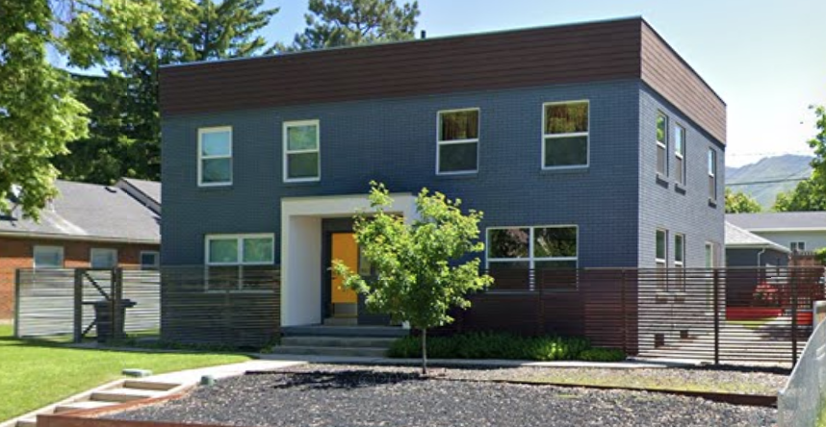
Predict the Price!
1589 S 1500 E, Salt Lake City, UT 84105
Square Ft: 2788
Bed Rooms: 4
Bathrooms: 3
Notes:
1589 S 1500 E, Salt Lake City, UT 84105
Add a view in Google My maps without the prices

Slide 16
Other Homes
Square Ft | Bed Rooms | Bathrooms | Price
2366 | 5 | 3.5 | $1,385,000
1586 | 4 | 2 | $785,000
3302 | 5 | 4 | $1,145,200
2100 | 4 | 2 | $788,600
2218 | 5 | 2 | $735,000
Square Ft: 2788
Bed Rooms: 4
Bathrooms: 3
Guesses
Participant | Guess Sales Price
True Price: $1,190,000
Model Predicted Price: $920,014
Notes:
1589 S 1500 E, Salt Lake City, UT 84105

Slide 17
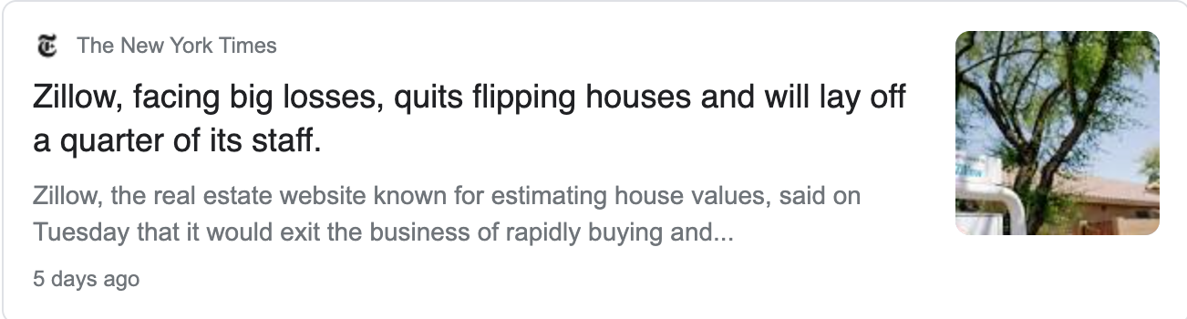
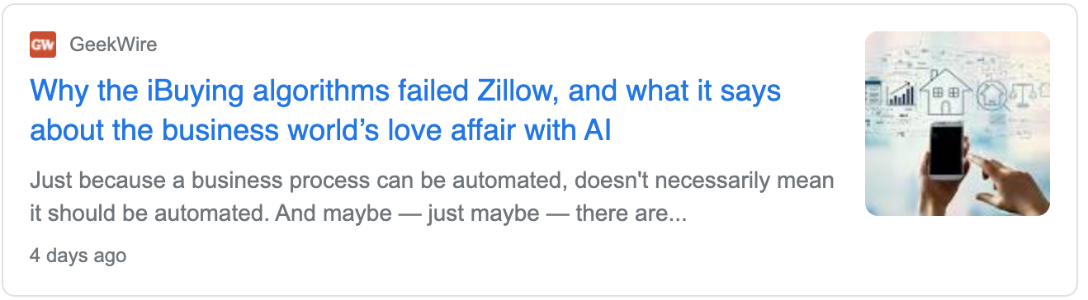
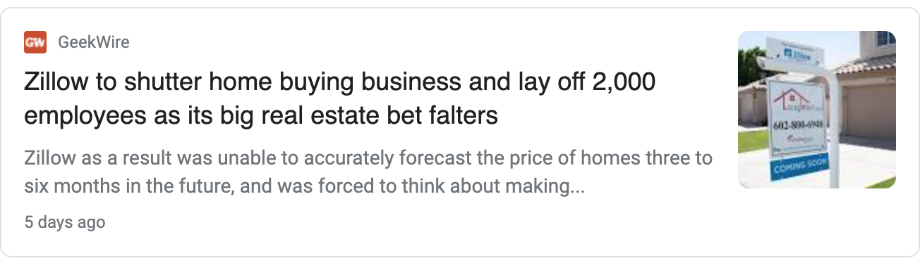
Machine Learning is not Magic

Slide 18
Thank you
https://github.com/VincentLa/neumont-college-teaching-sample
Questions?

